Slide 1

18ECE340T- MACHINE PERCEPTION WITH COGNITION
UNIT-2
Distance Functions, Skeleton and Thinning,
Deformable shape analysis and Boundary tracking procedures
Reference Book:
Computer and Machine Vision by E.R.Davies

Slide 2
DISTANCE FUNCTIONS AND THEIR USES

Slide 3
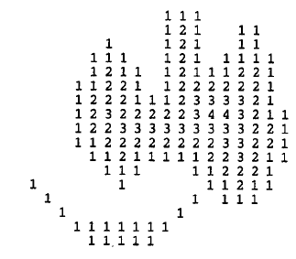
Distance Functions
The distance measurements is that between two specified pixels (x1,y1) and (x2,y2).
Each pixel in the object is numbered according to its distance from the background.
Background Pixel as 0.
Edge Pixel is counted as 1.
Object pixels next to 1’s become 2’s, next to those are the 3’s and so on throughout all the object pixels as shown in Figure.

Slide 4

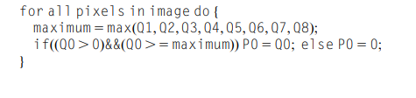
Distance Functions – Data Compression
An interesting application of distance functions---→data compression
Operations are carried out to locate the pixels that are local maxima of the distance function
Storing these pixel values and positions permits the original image to be regenerated by a process of downward propagation
To locate the local maxima, parallel routine may be employed.
The compressed data can be transferred to a single image space:

Slide 5
Distance Functions – Data Compression
As a result of this, it is found that the local maxima group themselves into clusters of connected points, each cluster having a common distance value and being separated from points of different distance.
The set of local maxima of an object is not a connected subset. This fact has an important bearing on skeleton formation.
A parallel downward propagation algorithm for recovering the shapes of objects from an image into which the values of the local maxima have been inserted.

Slide 6
Distance Functions – Data Compression
As a result of this, it is found that the local maxima group themselves into clusters of connected points, each cluster having a common distance value and being separated from points of different distance.
The set of local maxima of an object is not a connected subset. This fact has an important bearing on skeleton formation.
A parallel downward propagation algorithm for recovering the shapes of objects from an image into which the values of the local maxima have been inserted.

Slide 7
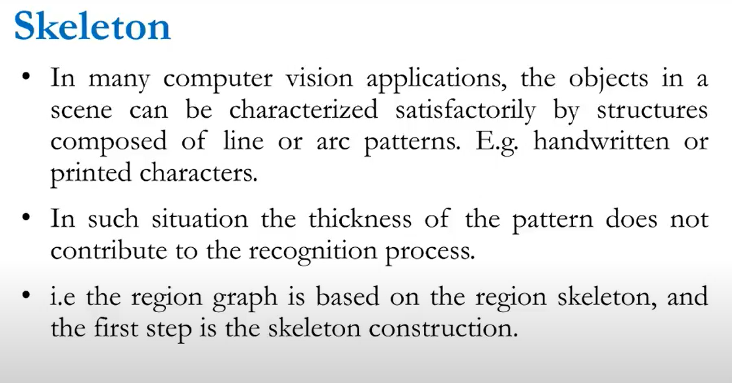
Erosion of an image

Slide 8
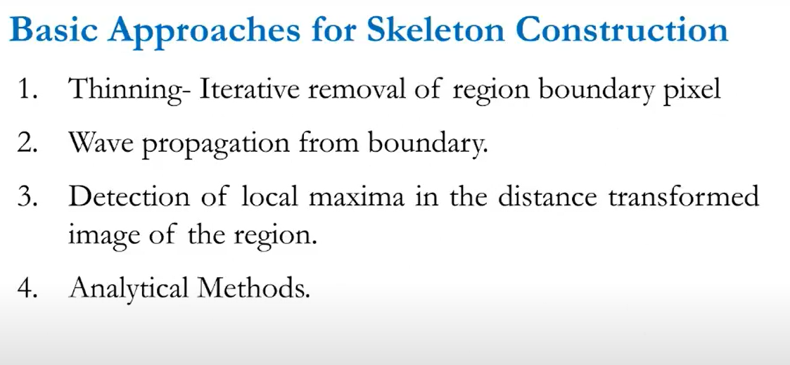

Slide 9
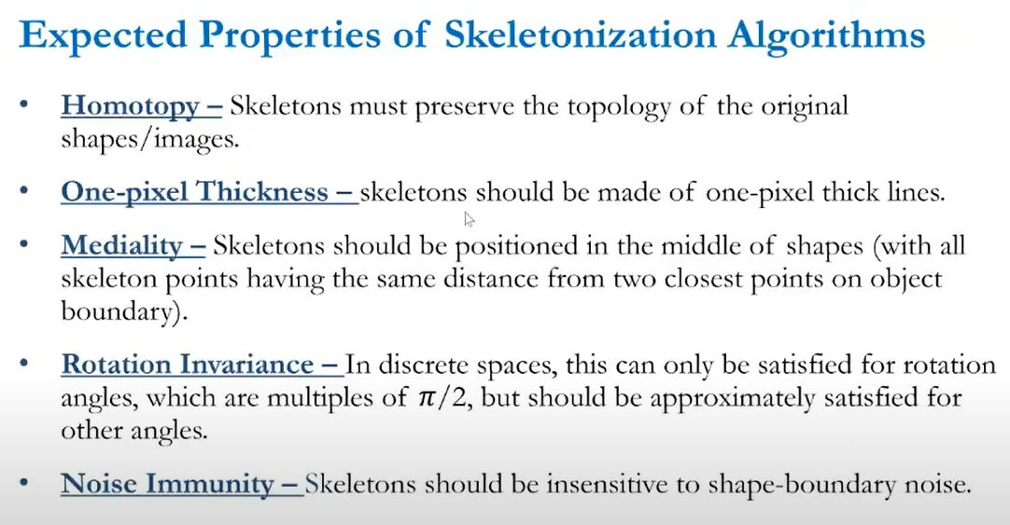

Slide 10
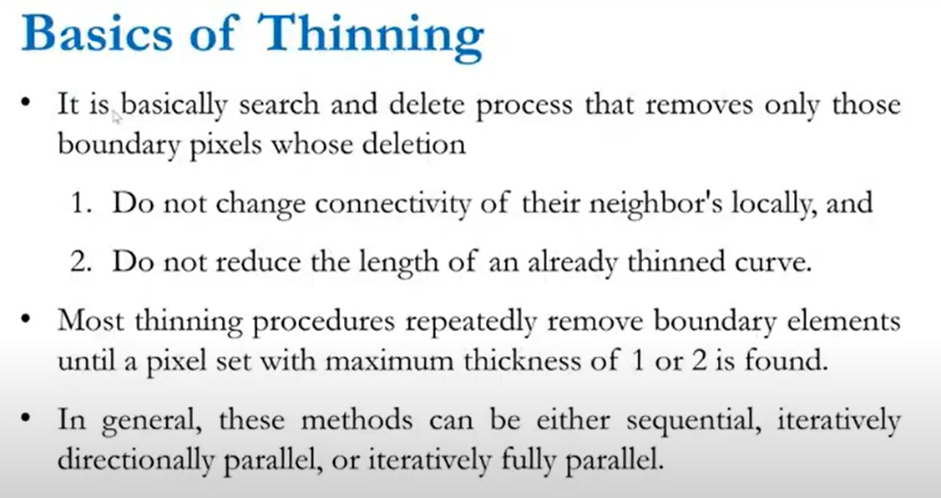

Slide 11
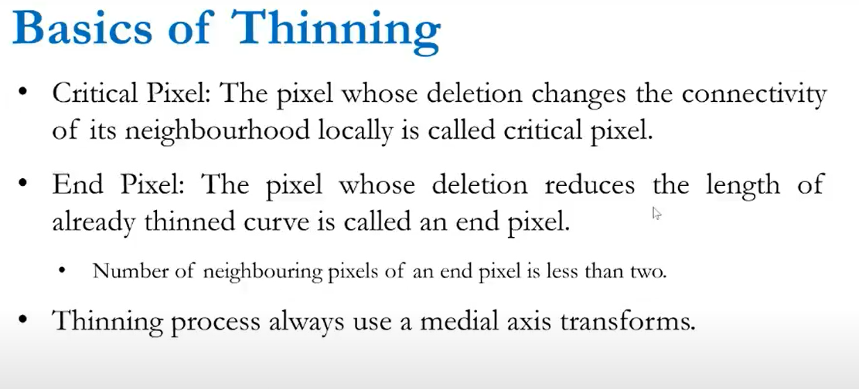

Slide 12
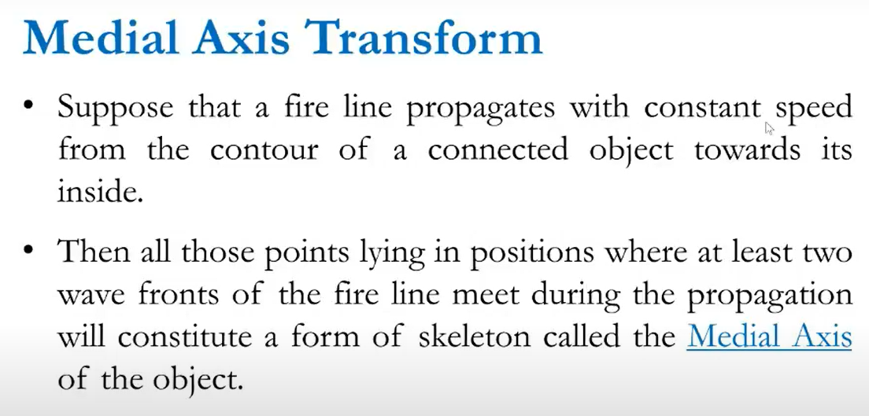

Slide 13
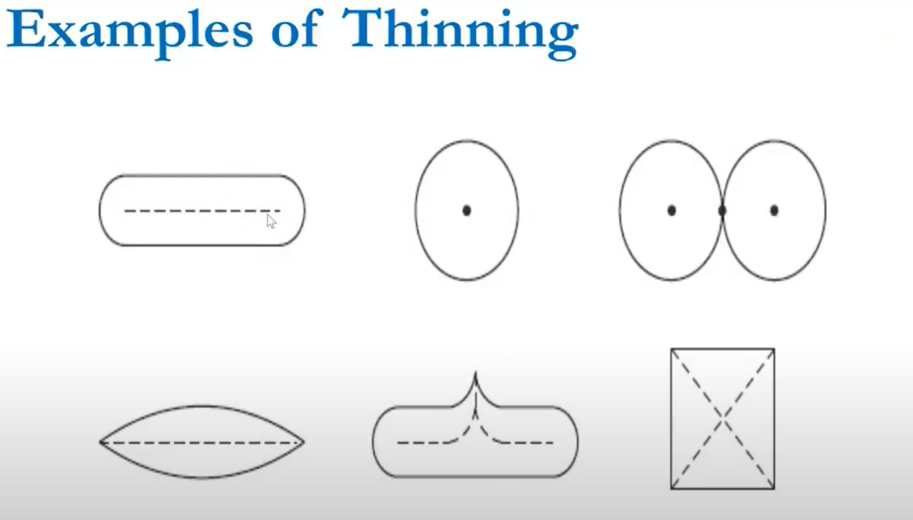

Slide 14
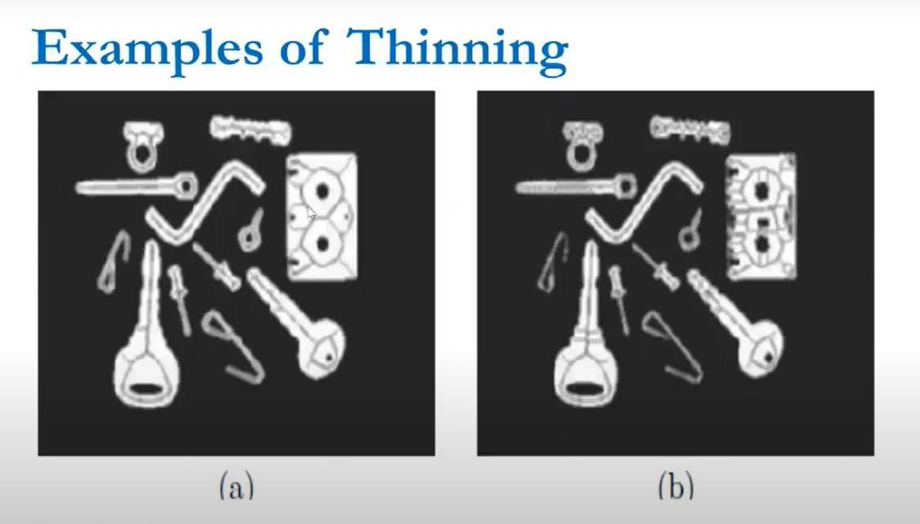

Slide 15
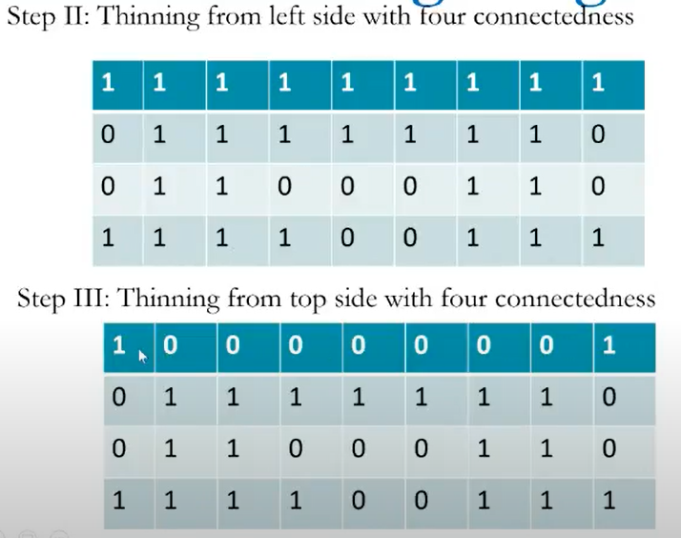
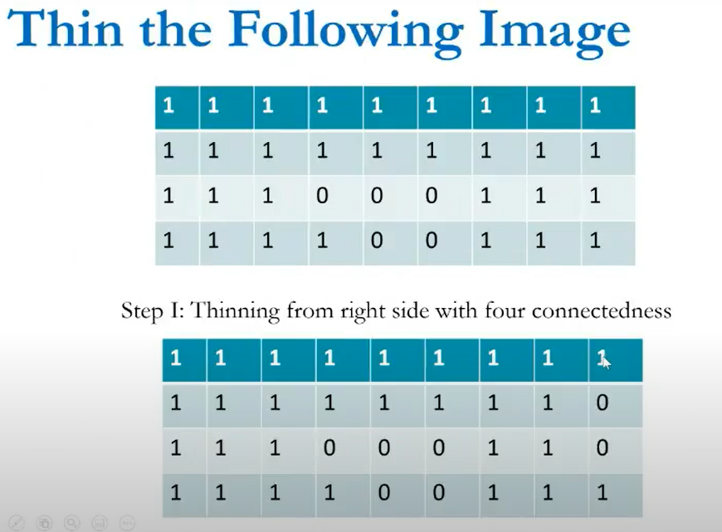
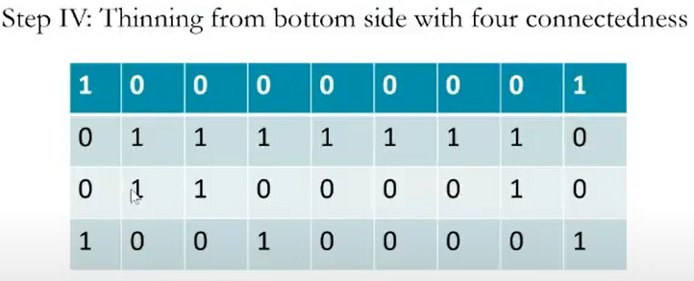
Thin the Image

Slide 16
Skeletons and Thinning
Skeletonization is a process for reducing foreground regions in a binary image to a skeletal remnant that largely preserves the extent and connectivity of the original region while throwing away most of the original foreground pixels.
Thinning is a morphological operation that is used to remove selected foreground pixels from binary images, somewhat like erosion or opening..

Slide 17
Skeletons and Thinning
The skeleton is the framework that provides structure to the rest of the body and facilitates movement.
USES: Analysis and Description of shapes in binary images.
DEFINITION: A skeleton may be defined as a connected set of medial lines along the limbs of a figure.
EXAMPLE: Thick hand-drawn characters:
The skeleton be supposed to be the path traveled by the pen.
BASIC IDEA:
Eliminating redundant information while retaining only the topological information concerning the shape and structure of the object that can help with recognition.

Slide 18
Erosion of an image
Morphology is known as the broad set of image processing operations that process images based on shapes. It is also known as a tool used for extracting image components that are useful in the representation and description of region shape. The ouputs are image attributes.
The basic morphological operations are:
Erosion
Dilation

Slide 19
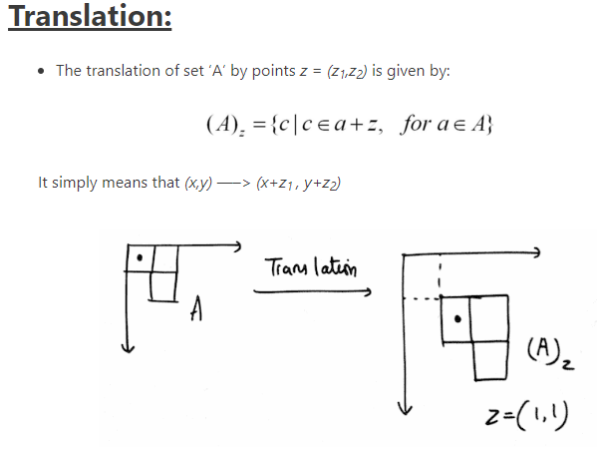
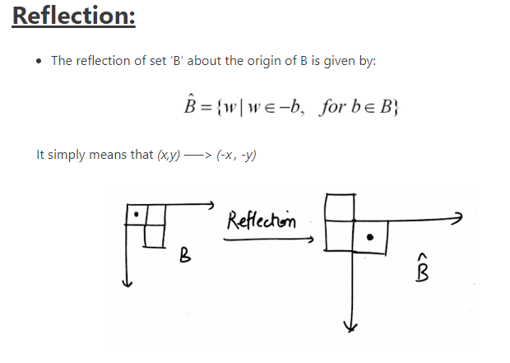
Morphological Processing

Slide 20
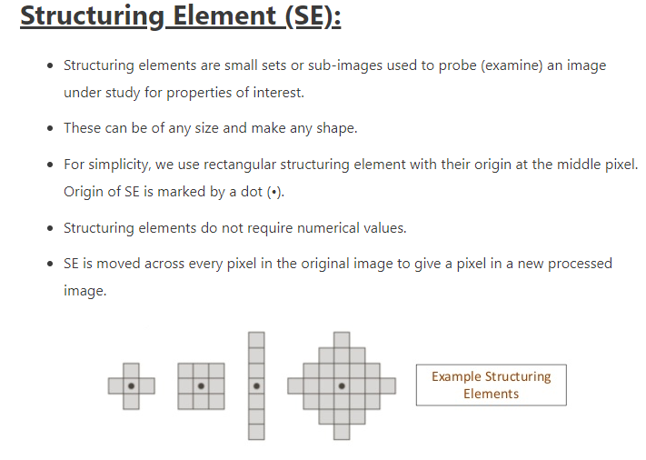
Morphological Processing

Slide 21
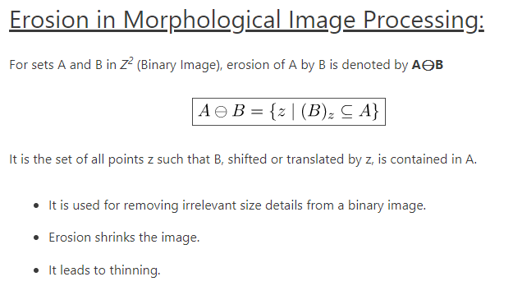
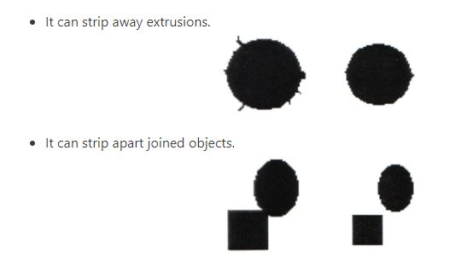

Morphological Processing
$$A=πr^{2} ⊖$$

Slide 22
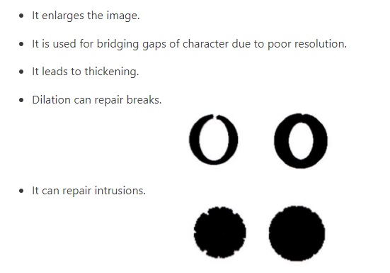
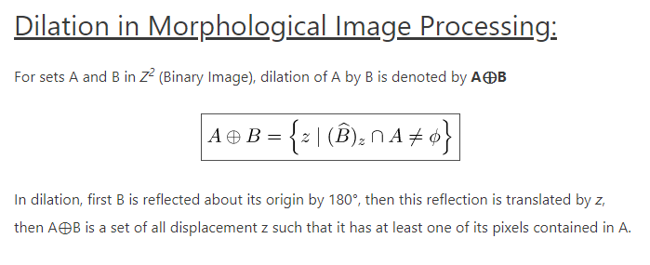
Morphological Processing

Slide 23
Erosion of an image
Erosion: Erosion shrink-ens the image pixels i.e. it is used for shrinking of element A by using element B.
Erosion removes pixels on object boundaries.:
The value of the output pixel is the minimum value of all the pixels in the neighborhood. A pixel is set to 0 if any of the neighboring pixels have the value 0.

Slide 24
Erosion of an image
Approach:
Read the RGB image.
Using function im2bw(), convert the RGB image to a binary image.
Create a structuring element or you can use any predefined mask eg. special(‘sobel’).
Store the number of rows and columns in an array and loop through it.
Create a zero matrix of the size same as the size of our image.
Leaving the boundary pixels start moving the structuring element on the image and start comparing the pixel with the pixels present in the neighborhood.
If the value of the neighborhood pixel is 0, then change the value of that pixel to 0.

Slide 25
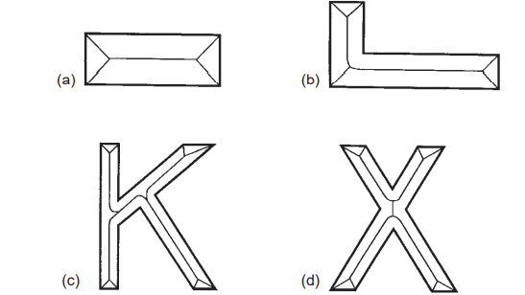
Skeletons and Thinning
FINDING THE LOCI:
1.Angle bisectors
2.Lines
3.Parabolas
DRAWBACK OF LOCAL MAXIMA:
Does not form a connected graph within a given object nor is it necessarily composed of thin lines

Slide 26
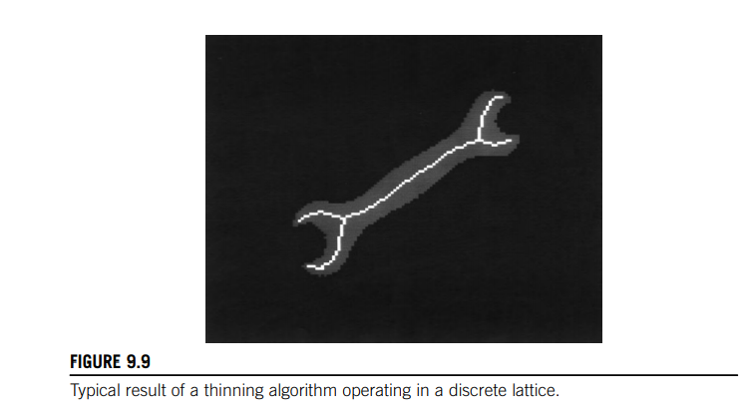
An alternative idea—that of thinning
DEFINITION:
Defined as the process of systematically stripping away the outermost layers of a
figure until only a connected unit-width skeleton remains.
To discuss the mechanism by which points on the boundary of a figure may validly be removed in thinning algorithms

Slide 27
Deformable shape analysis
A method for deformable shape detection and recognition is described.
Deformable shape templates are used to partition the image into a globally consistent interpretation
determined in part by the minimum description length principle
Statistical shape models enforce the prior probabilities on global, parametric deformations for each object class.
Once trained, the system autonomously segments deformed shapes from the background, while not merging them with adjacent objects or shadows.
The formulation can be used to group image regions obtained via any region segmentation algorithm, e.g., texture, color, or motion.
The recovered shape models can be used directly in object recognition.
Experiments with color imagery are reported

Slide 28
BOUNDARY TRACKING PROCEDURES
Methods of analyzing shape on the basis of body representations such as skeletons and moments.
Boundary pattern analysis:
ADVANTAGE: Reduced computation
DISADVANTAGE: The number of pixels to be examined is equal to the number of pixels on the boundary of any object rather than the much larger number of pixels within the boundary.
Objects having unit width in certain places maybecome disconnected.

Slide 29
There is still a problem when objects have unit-width sections
since these can cause badly designed tracking algorithms to choose a wrong path, going back around the previous section instead of on to the next
To avoid this circumstance it is best to adopt the following strategy:
1. track round each boundary, keeping to the left path consistently
2. stop the tracking procedure only when passing through the starting point in the original direction (or passing through the first two points in the same order).

Slide 30
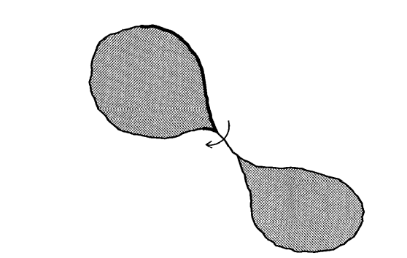
Boundary tracking algorithm
A problem with an over-simple boundary tracking algorithm
The boundary tracking procedure takes a short-cut across a unit-width boundary segment instead of continuing
and keeping to the left path at all times

Slide 31
Thinning Problem

